Slide 1

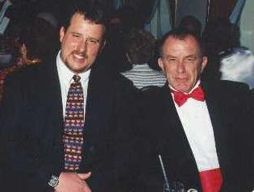
Exposure CS 2021
for CS1
Chapter 6 Section 9-10 Slides
More Python Libraries:
Displaying Graphics Text & Subroutine Review
PowerPoint Presentation
created by:
Mr. John L. M. Schram
and Mr. Leon Schram
Authors of Exposure
Computer Science

Slide 2
Section 6.9
Displaying
Graphics Text

Slide 3
Procedure drawString
drawString("Hello There!", x, y)
Draws any string starting at coordinate (x,y).
Hello There!
x, y

Slide 4
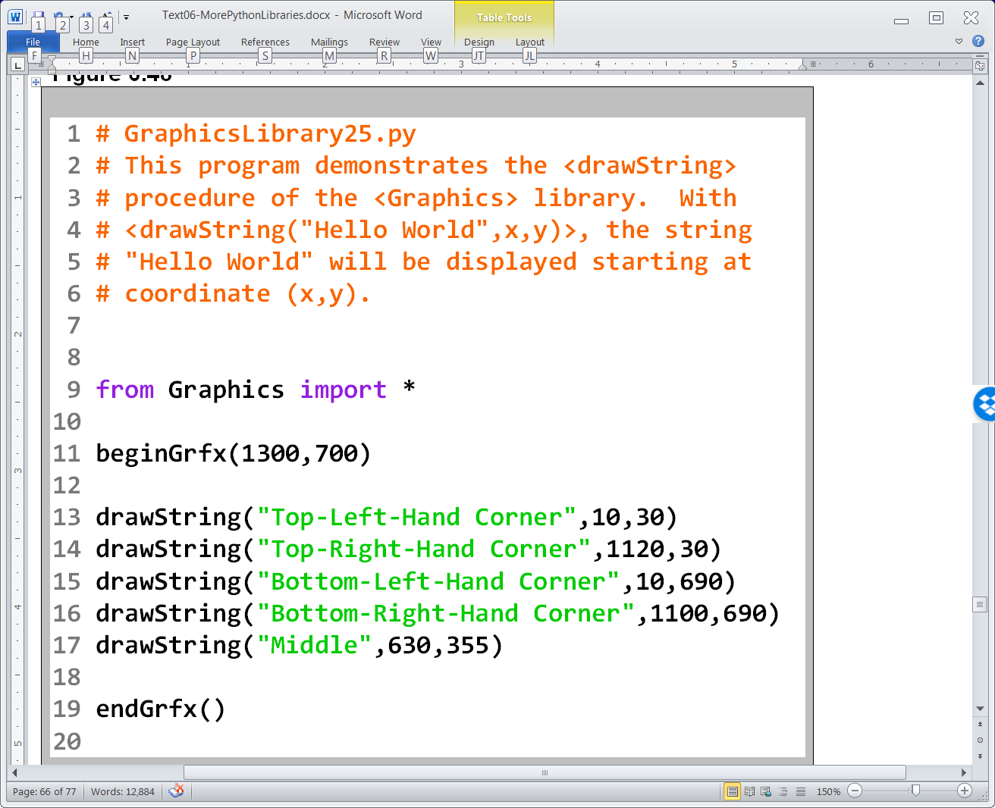

Slide 5
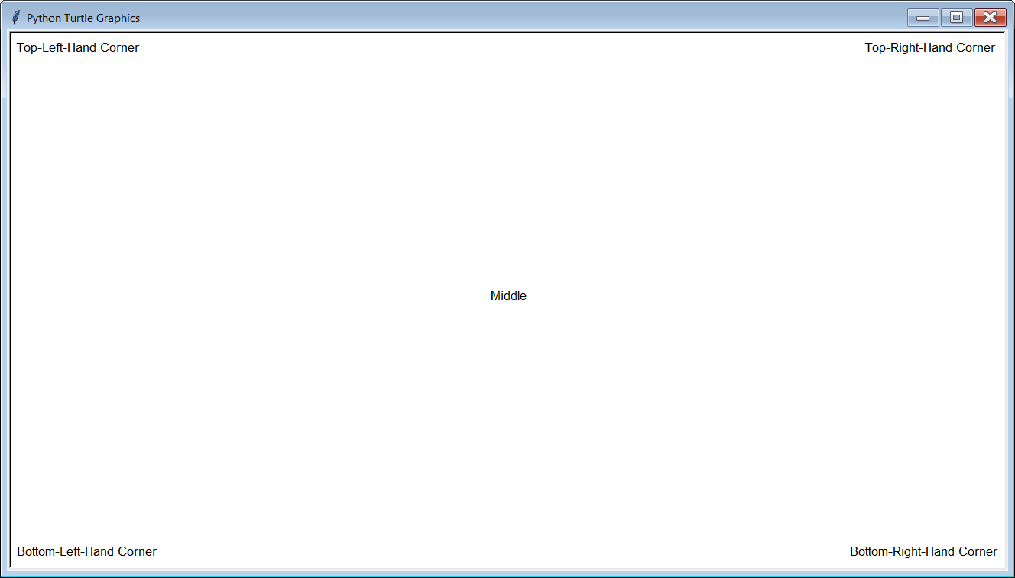
GraphicsLibrary25.py Output

Slide 6
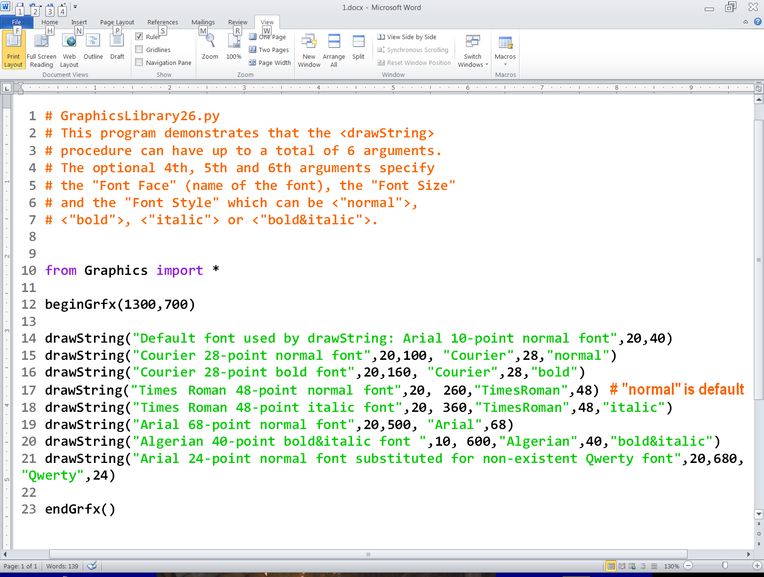

Slide 7
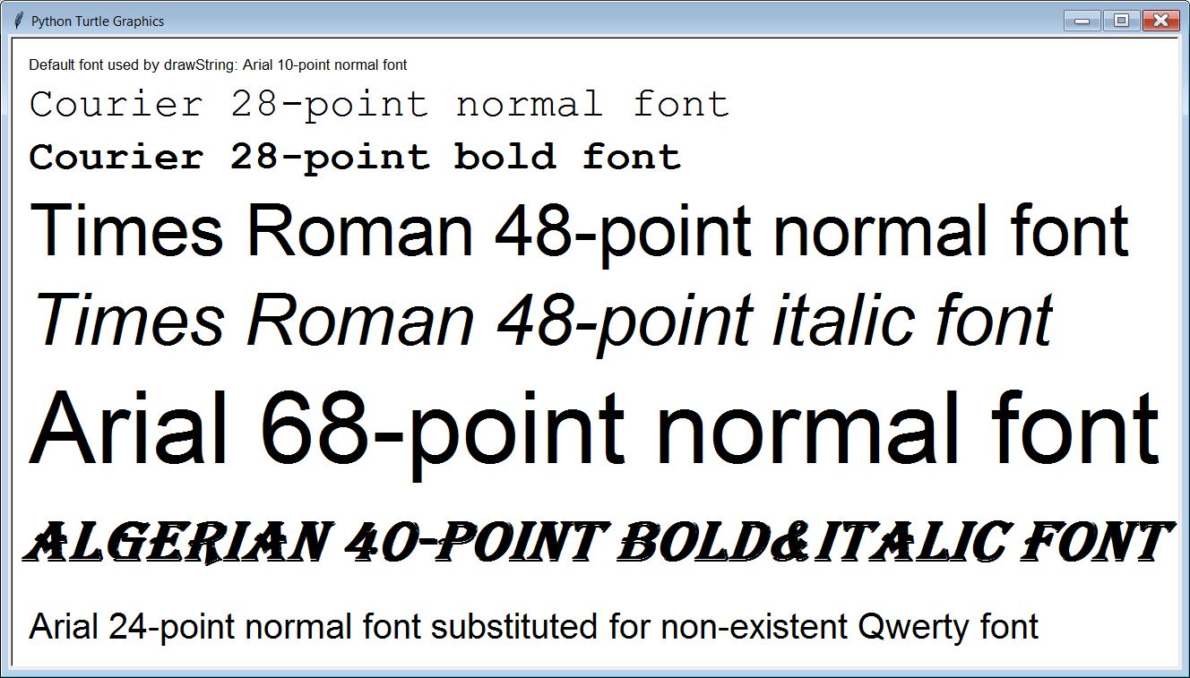
GraphicsLibrary26.py Output

Slide 8
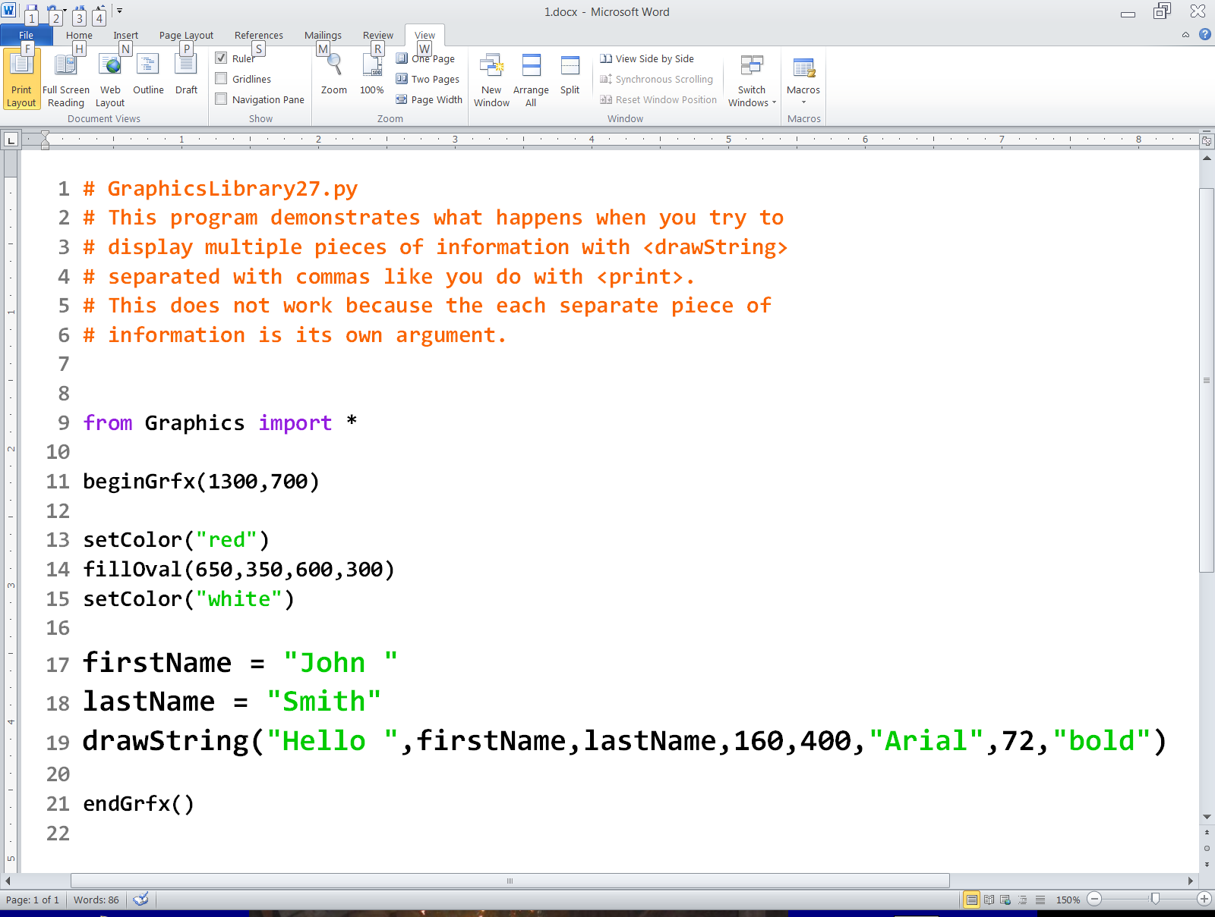

Slide 9
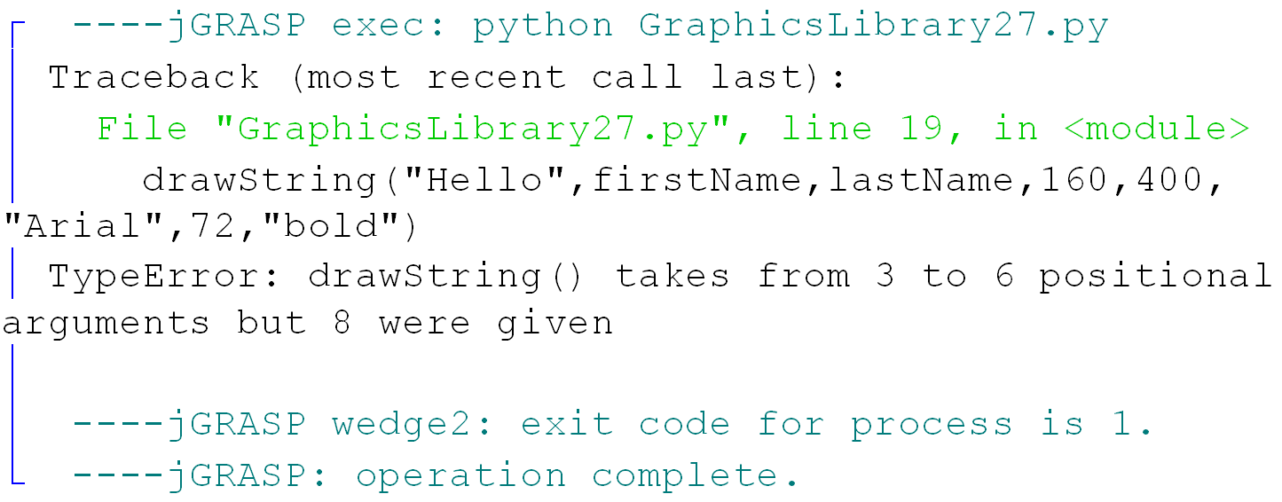

Slide 10
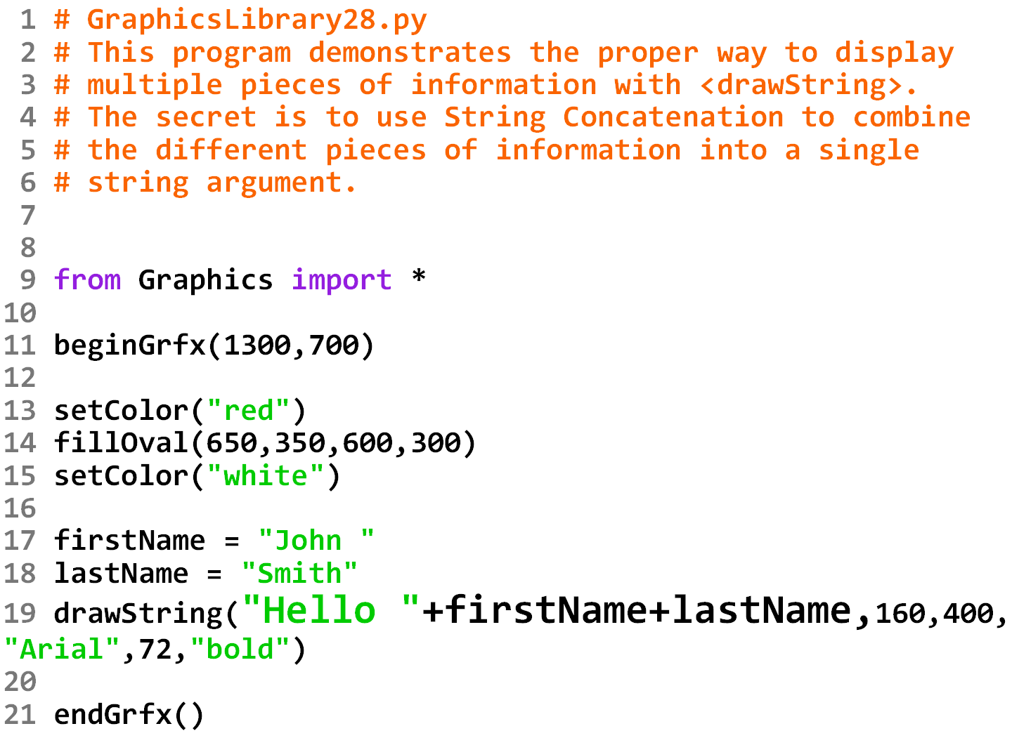

Slide 11
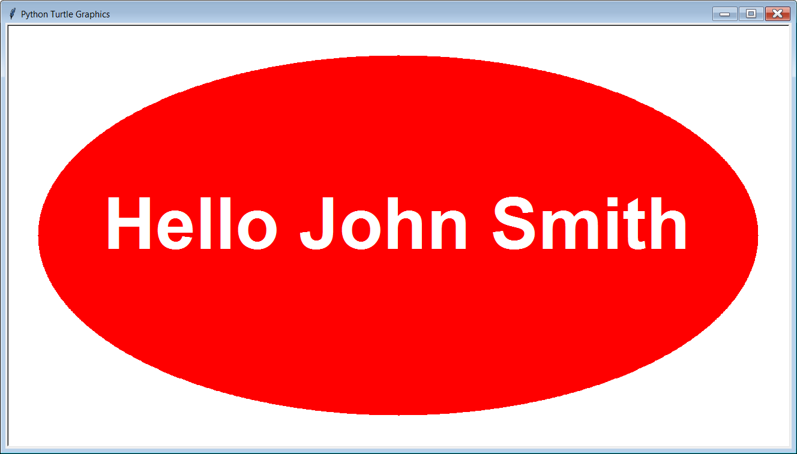

Slide 12
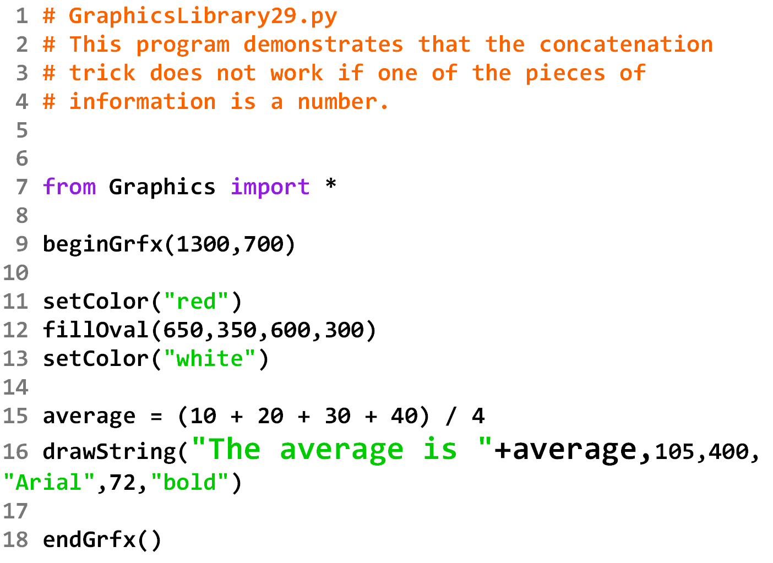

Slide 13
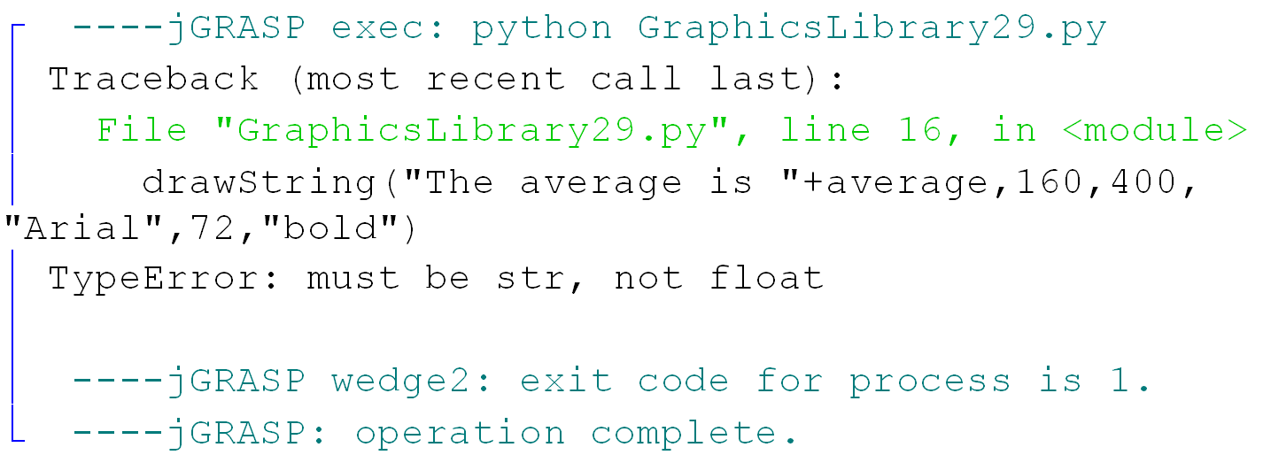

Slide 14
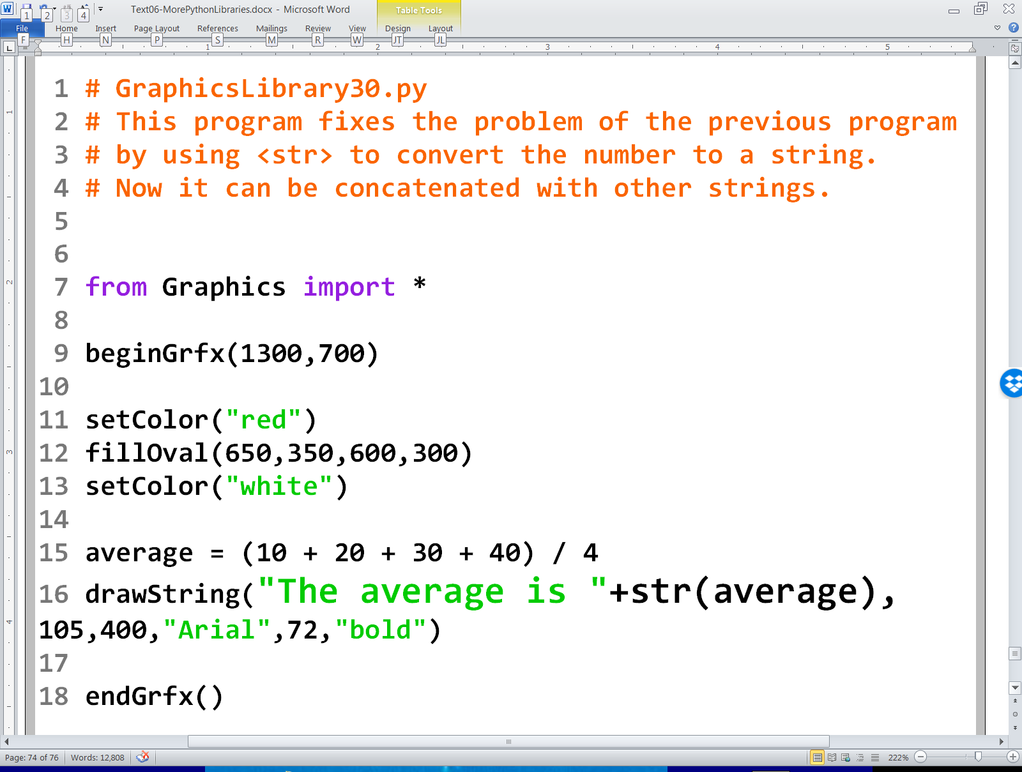

Slide 15
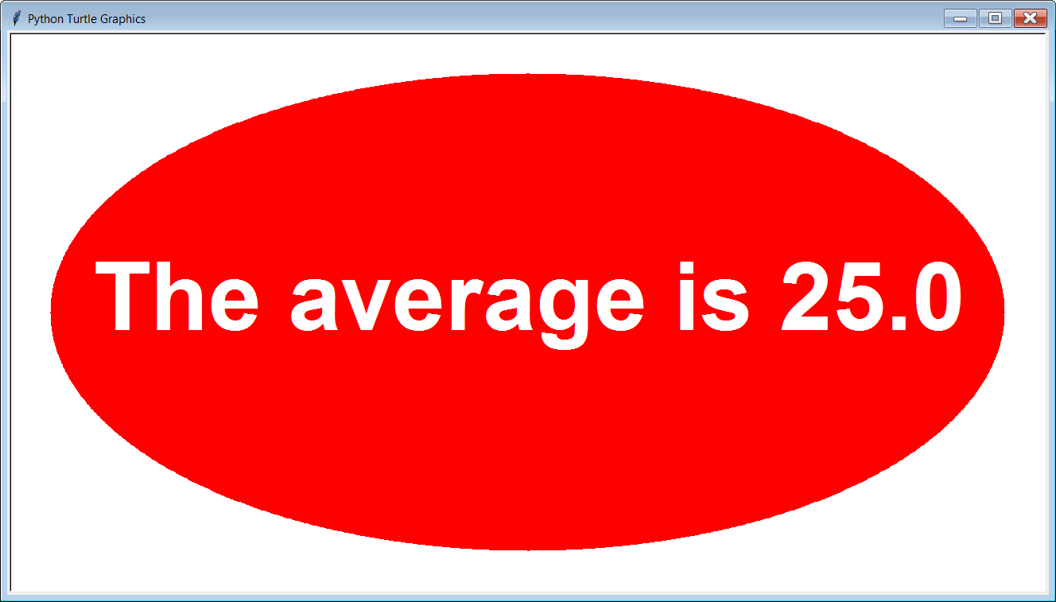

Slide 16
Section 6.10
Review:
Functions vs.
Procedures

Slide 17
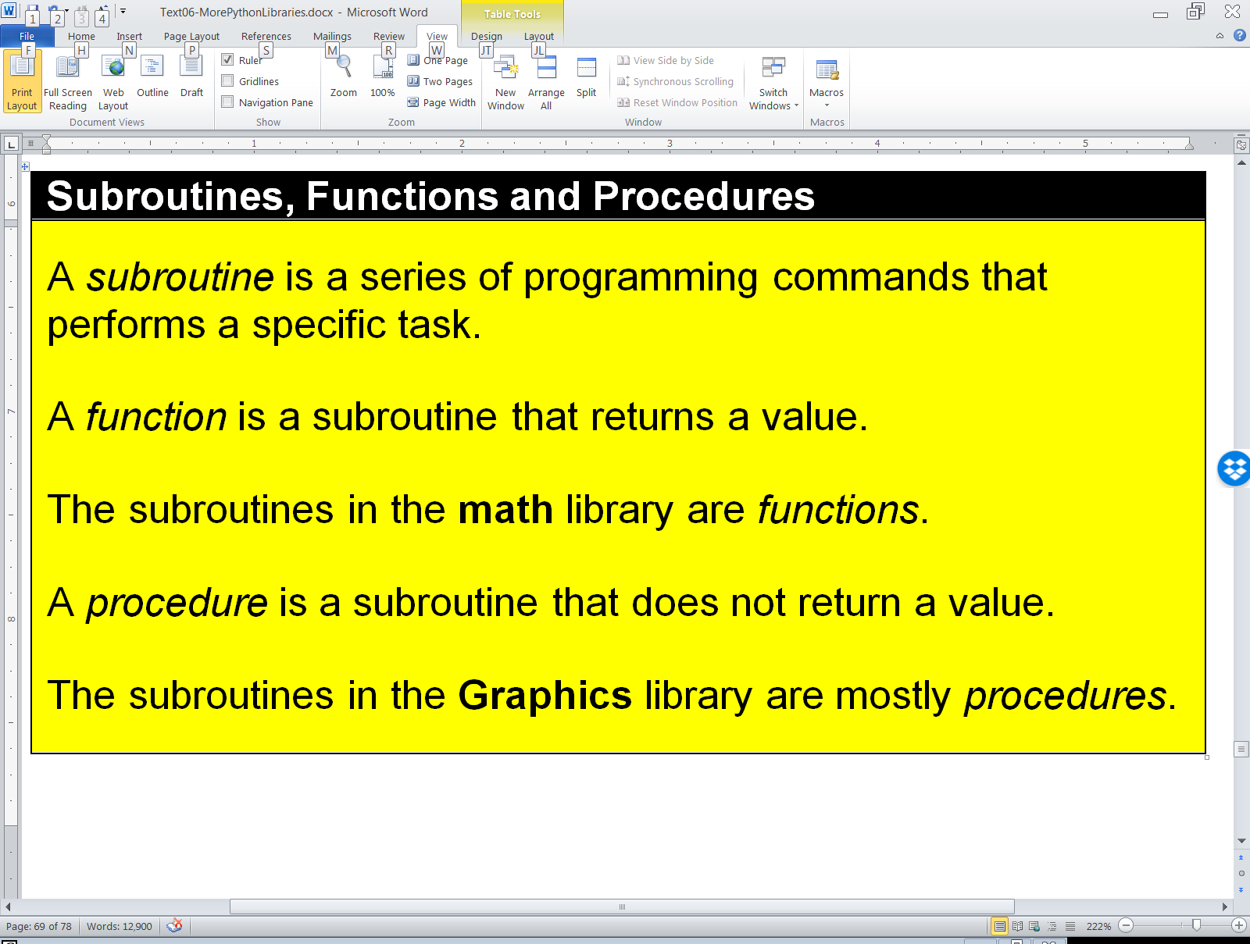
Subroutines, Functions and Procedures Review

